Slide 1
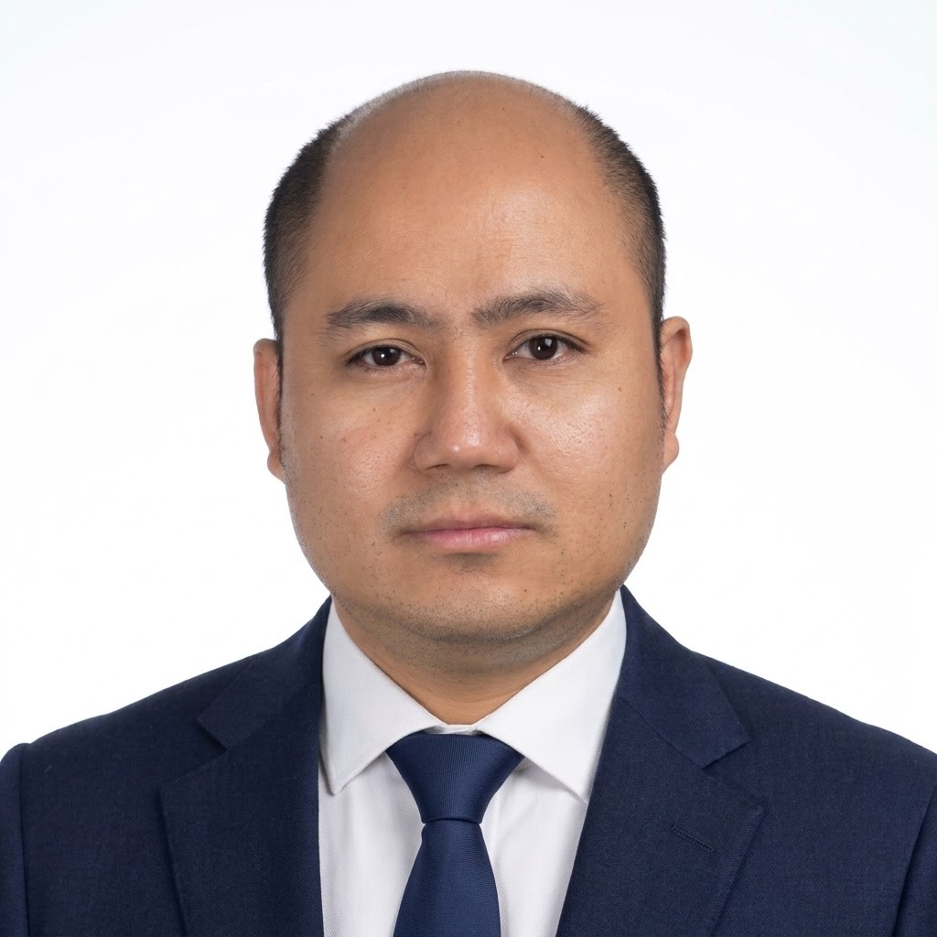
Aaron A. Macapagal
In software since 2006. Application development started around 2008.
Specializes in Azure, AWS, full-stack delivery, and architecture. AZ-900 certified.
Industries
App Development
Cloud Engineering
Software Architecture
Full-Stack
Databases
DevOps
Technology
C#, .NET Core, ASP.NET, C++
TypeScript, JavaScript, SQL
Azure, AWS, SQL Server, MySQL
Git, Azure DevOps, CI/CD
VB.NET, HTML, CSS, Bootstrap, jQuery
REST APIs, GraphQL, Angular, SignalR
Entity Framework, LINQ, XUnit, Postman
Kubernetes, microservices, Helm, ArgoCD
Industry Workload
Technical
90%
Automation
50%
Leadership
80%
Recent Projects
PWC State Income Tax
Since October 2024: workpaper import, slide-out, DRD core, and calculator.
Ended October 31, 2026. Pipeline, SDK retirement, and the Rollover Agent.
PWC Beacon
Tableau system, rebuilt on the Power Platform toward Power BI.
Explored .NET SDK options for the conversion.
Azure Application Development
Lead envisioning, design, and scope for Azure solutions.
Turn business requirements into scalable architectures.
Guide Azure cloud adoption and clear blockers.
Work in pods of 7-10 developers and quality engineers.
* Mentor engineers and interview incoming talent.
Education
BACHELOR OF SCIENCE IN COMPUTER SCIENCE
HOLY ANGEL UNIVERSITY
Angeles City, Philippines (2015)
Certifications
AZ-900: Azure Fundamentals

